Slide 1
Fraud Detection and Risk Assessment AI-Chatbot System
By Chirag Dwivedi and Shadmaan akhand

Slide 2
Traditional Fraud Detection Systems
Traditional fraud detection systems have historically relied on simple rule-based logic. These systems operate on predefined rules created by human analysts, such as “flag any transaction over $5,000 at 2 AM” or “block transfers to new accounts over a certain threshold”. While these rules are straightforward to implement and easy to understand, they come with major limitations. Because they are rigid and static, bad actors can quickly learn how these rules work and adapt their strategies to avoid detection(often by staying just below the defined thresholds). This results in many false negatives, where fraudulent transactions go unnoticed. At the same time, rule-based systems tend to produce a high number of false positives, flagging many normal transactions simply because they match a specific rule. This creates unnecessary friction for customers and increases the workload for investigators, who then must manually review each flagged case.
Rule-based detection system:
  Use simple predefined rules to identify suspicious transactions
  Easy to implement but inflexible and predictable
Anomaly-based detection system:
  Flag unusual activity compared to normal behavior
  Can detect unexpected patterns but often produce false alarms
Manual determination:
  Analysts review flagged cases and make final decisions
  Time-consuming and prone to human error
Machine learning/Artificial Intelligence system:
  More adaptive and capable of detecting subtle fraud behavior
  Learn patterns from large datasets to improve accuracy

Slide 3
AI/ML in Fraud Detection Systems
Artificial Intelligence and Machine Learning fundamentally transformed this space by introducing systems capable of recognizing complex behavioral patterns that humans cannot easily define. Instead of relying on a handful of static rules, ML models analyze patterns across thousands or even millions of past transactions to learn what fraud typically looks like. They capture subtle, non-obvious relationships (such as unusual sequences of transactions, sudden shifts in account balance behavior, or abnormalities that don’t fit historical norms, etc).
Unlike traditional systems, AI continuously adapts as new fraud strategies emerge, making it more resilient to evolving criminal techniques. Additionally, ML models can process massive amounts of data extremely quickly, allowing for real-time or near-real-time fraud detection with far greater accuracy and significantly fewer false alarms.

Slide 4
Benefits/advantages of ai in FDS
AI can analyze transactions within milliseconds to determine of it is a fraud or not.
Fraud pattern change frequently which traditional FDS may not be able to handle. AI driven FDS tend to adapt to changing fraud patterns easily.
Higher accuracy than rule-based systems as it reduces false positives and false negative predictions.
Provides explainability using AI chatbots.

Slide 5
Issues with AI/ML based Fraud Detection Systems
Even though modern machine learning models have become extremely accurate at identifying fraudulent transactions, they still suffer from one major limitation: they typically do not explain why a transaction was flagged. Most fraud detection systems simply output a binary decision, “Fraud” or “Not Fraud”, without providing any insight into what patterns or features contributed to that prediction.
Because of this, human analysts are forced to manually investigate each alert by looking through transaction logs, checking balance changes, comparing similar past fraud cases, and trying to infer the model's reasoning on their own. This process is slow, labor-intensive, and difficult to scale, especially for institutions handling millions of transactions per day.
The lack of transparency also delays fraud response time and reduces trust, since neither businesses nor customers receive clear explanations. As a result, there is a growing need for fraud detection systems that not only classify transactions, but also clearly communicate why a transaction appears suspicious.
Missing Feature: Explainability
Businesses ask, "why was this transaction flagged?".
Users ask, "is my account in danger?".

Slide 6
Chatbot solution with reliable analysis and summarization
By lessening the black box nature of AI/ML models and providing in-depth explanations/potential solutions, this AI-chatbot greatly diminishes the burden on security. Security Analysts want systems that don’t just flag fraud, they want systems that explain the reasoning. Without explanations or clear signs, analysts must manually investigate every alert, slowing down response time and reducing trust. Explainability helps security teams understand risk faster, make better decisions, and communicate clearly with customers and auditors.
How it works:
Random Forest based Fraud Detection Model
  Predicts whether a transaction is fraudulent based on patterns in the data.
Chatbot Layer
  Reads the transaction
  Interprets the model output based on its training
  Provides a human-readable explanations such as which variables contributed most, why the model scored it as fraud, what risk factors triggered detection, etc
Example output:
“This transaction is likely fraud because the amount is unusually high, the old balance was low, and the destination account historically appears in fraudulent patterns.”

Slide 7
Explaining the Data used to create the Detection Model
Dataset: “Fraud Detection Dataset” by Aman Ali Siddiqui (Kaggle)\
Size: 6.3 million real financial transactions
Extremely large sample size. Provides millions of examples for the model to learn diverse real-world behaviors.
Contains both fraudulent & non-fraudulent transactions. Ensures the model learns the difference between normal behavior and suspicious patterns.
Includes meaningful transaction attributes, such as:
  amount – size of the transaction
  oldbalanceOrg / newbalanceOrig – sender’s balance before and after
  oldbalanceDest / newbalanceDest – receiver’s balance before and after
  transaction type – CASH_OUT, TRANSFER, etc., which are common fraud channels
  isFraud – ground truth label used for training
Large datasets help the model by reducing:
  Overfitting – the model generalizes better instead of memorizing patterns
  Bias – more balanced learning across many cases
  Variance – more stable, consistent predictions

Slide 8
Explaining each Column/Category in the dataset and their importance
Column | Meaning
step | Time-step in hours
type | Type of transaction (CASH_OUT, TRANSFER, etc.)
amount | Transaction amount
oldbalanceOrg | Sender’s balance before transaction
newbalanceOrig | Sender’s balance after transaction
oldbalanceDest | Receiver’s balance before transaction
newbalanceDest | Receiver’s balance after transaction
isFraud | 1 = Fraud, 0 = Normal
isFlaggedFraud | Attempts to flag suspicious transactions
Why they matter:
Amount - Fraud often involves unusually large amounts.
oldbalanceOrg / newbalanceOrig - Shows whether money “disappears” unexpectedly.
oldbalanceDest / newbalanceDest - Fraud accounts often suddenly receive large deposits.
Type - Fraud heavily occurs in:
  CASH_OUT
  TRANSFER
IsFlaggedFraud - A manual rule but usually catches very little.
This is why AI/ML is needed.

Slide 9
Is this data reliable for a Random Forest Detection Model?
Short answer, yes. The dataset is extremely large and contains realistic financial behavior patterns, we can trust it to train a highly accurate machine learning model.
Reasons:
Huge sample size (6.3M rows) minimizes noise
Well-balanced real-world financial fields
Contains both fraudulent & non-fraudulent examples
Patterns are clear enough for Random Forest to perform very accurately

Slide 10
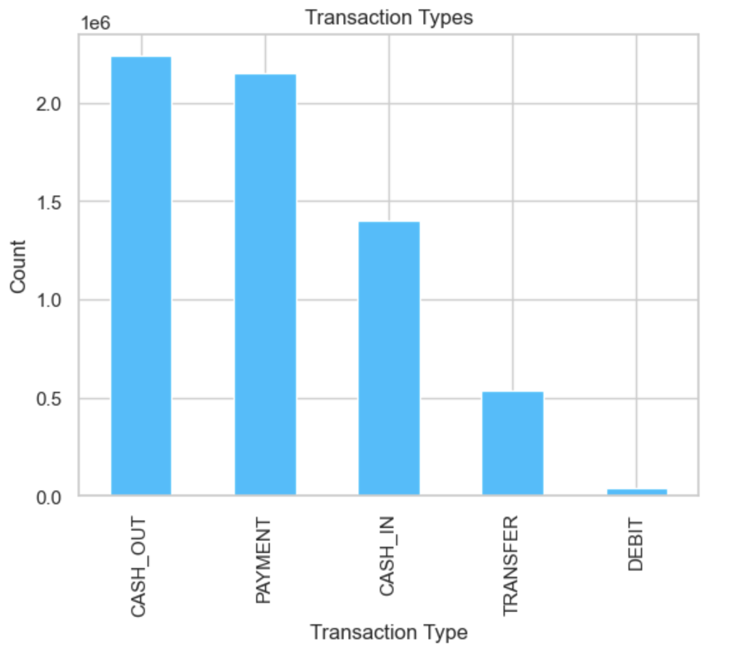
Data Visualizations
The bar chart shows the frequency for each type of transaction. According to the graph, Cashout and Payment dominate the dataset. The categorical distribution is highly informative and emphasizes the model’s need to handle categorical imbalances efficiently.

Slide 11
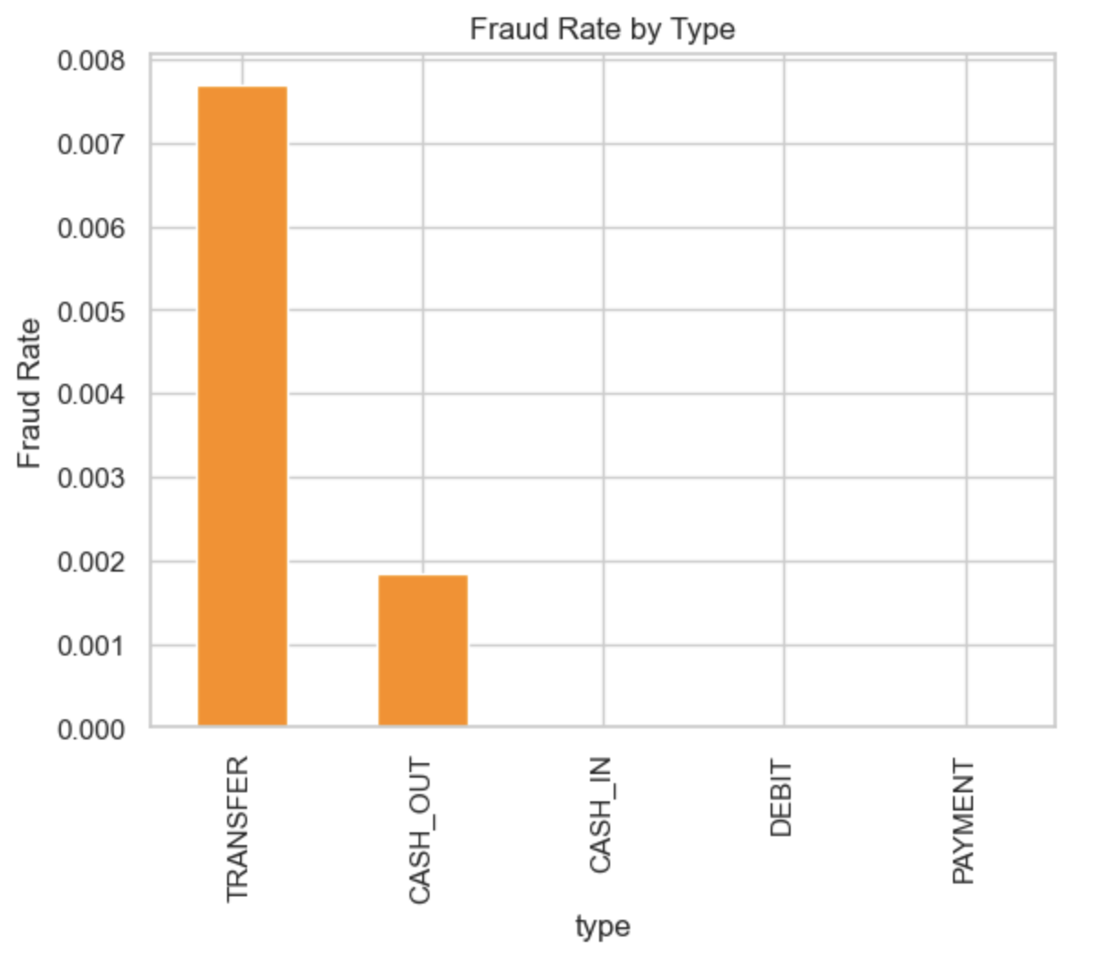
Data Visualizations
This fraud frequency by type chart shows that Cash Out and Transfer have the highest amount of fraud whereas types like Payment, Cash in and Debit have virtually no frauds. This reenforces to treat “Type” as a high impact predictive feature.

Slide 12
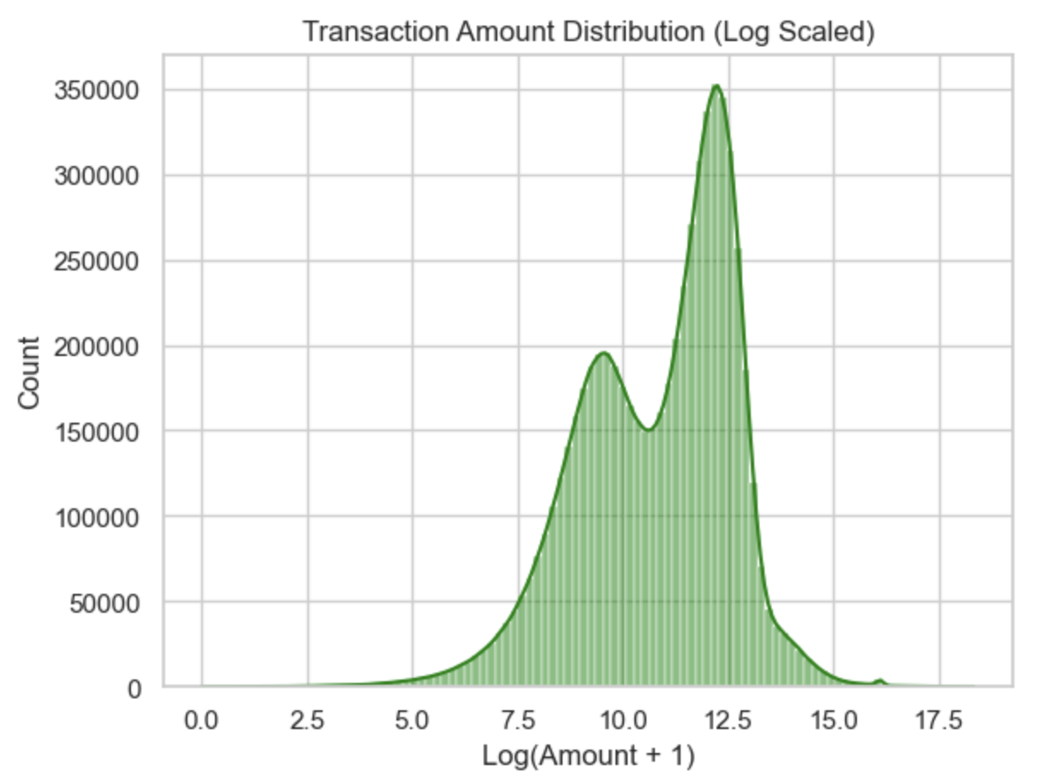
Data Visualizations
This density plot Shows the distribution of different transaction amounts. This gives an idea of what amount of transaction happens the most, which helps the model differentiates between normal transactions which are around the average amount and fraudulent transactions that happen at higher-than-average amounts.

Slide 13
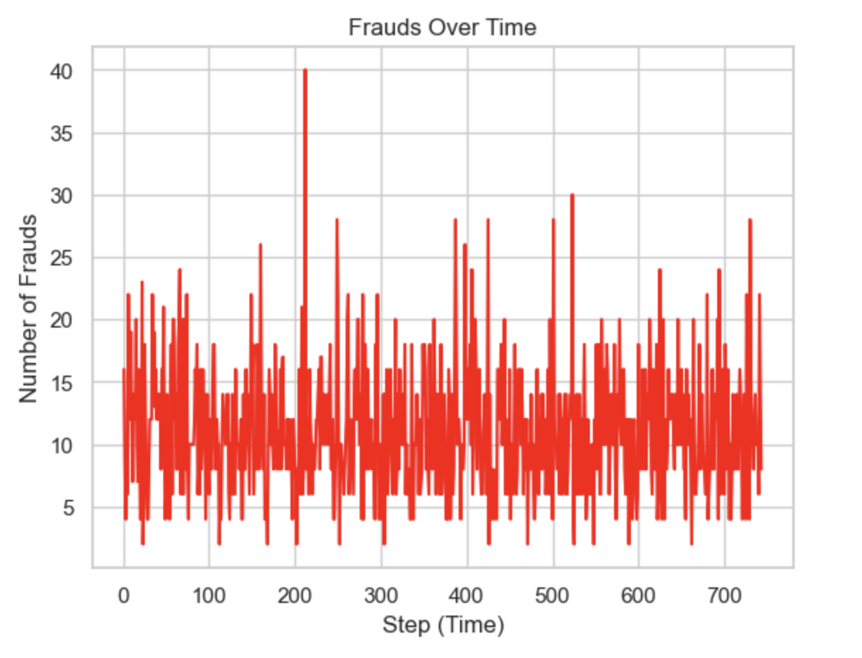
Data Visualizations
The graph shows the relationship between number of frauds and time. As one may observe, number of frauds stay constant overall across the graph. This means that fraud transactions are not seasonal and may happen throughout the year.

Slide 14
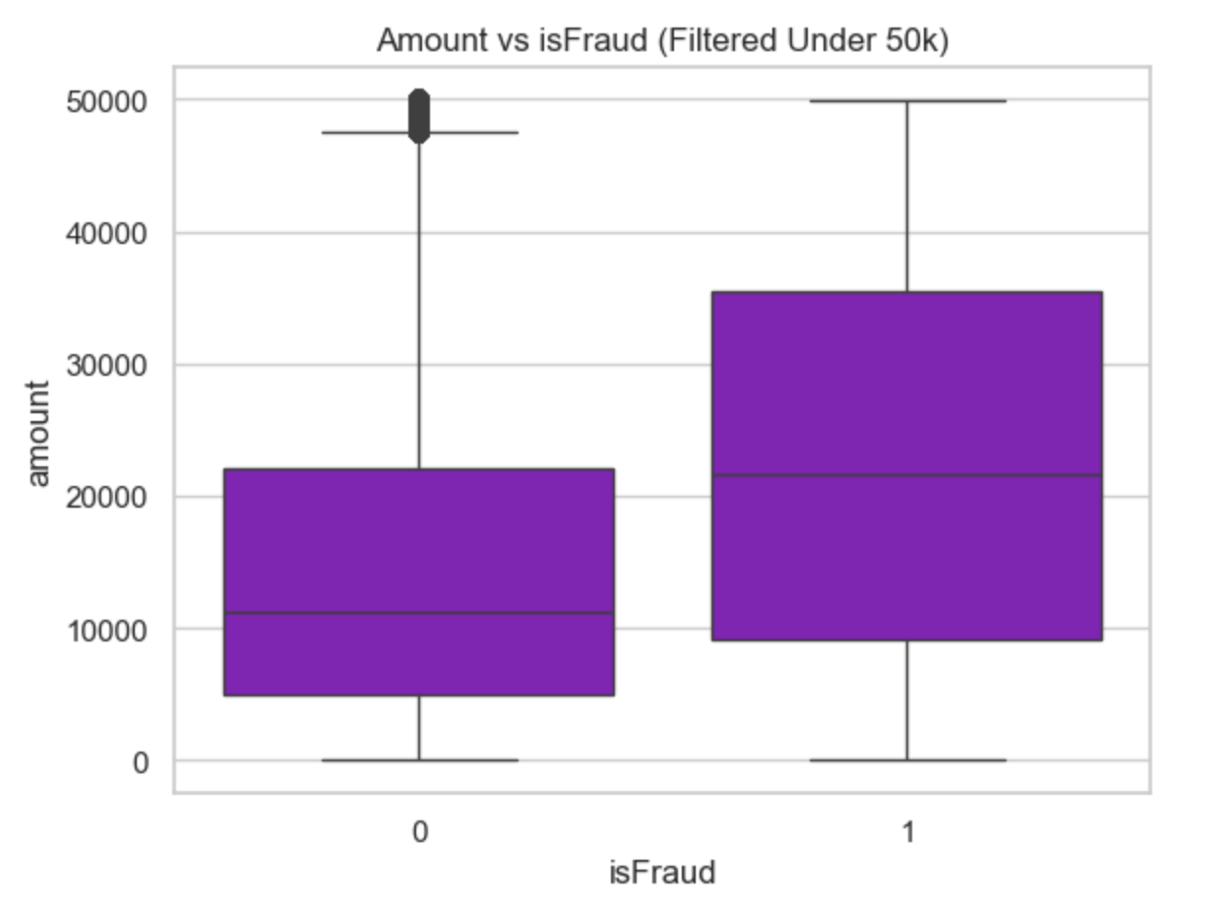
Data Visualizations
Figure shows two box plots. One for fraud transactions and the other for legitimate transactions. The boxplot shows that fraudulent transactions seem to have a much higher amount than legitimate transactions with the median and upper quartile significantly elevated. The plot shows that transaction amounts are a important factor.

Slide 15
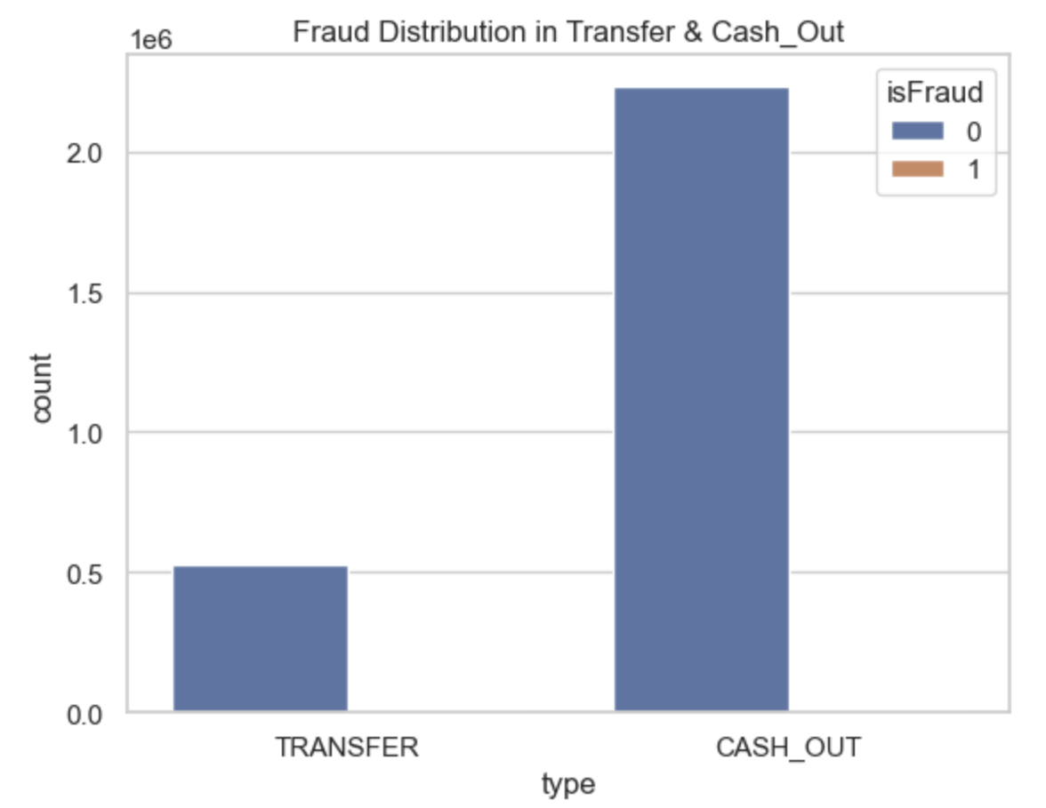
Data Visualizations
The Bar Graph shows the frequency of frauds for Transfer and Cashout, the two largest categories of fraud. From the graph most frauds happen in Cash Out transaction with almost 2 million frauds.

Slide 16
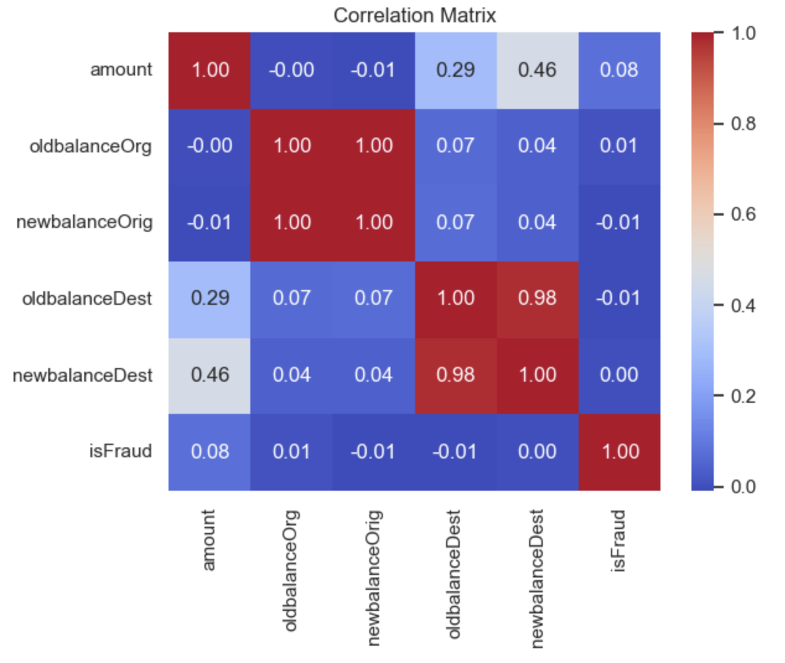
Data Visualizations
The heatmap reveals several important relationships:
  Sender and Receiver balance change
  Fraud has moderate relations with numerical features (amount: 0.08)

Slide 17
Technology Stack: Tools and Libraries used
Programming Language:
  Python – Main language used for program and development
Data Analysis and Processing:
  Pandas – Data Cleaning, Feature Selection, and transformation.
  NumPy – For Numerical Operations and Vectorized Computation.
Machine Learning Models and tools:
  Scikit-learn –
    Logistic Regression (Original Choice) and Random Forest (Final Choice)
  Joblib – Model serialization/loading in the web app.
Application Framework:
  Streamlit –
    Built the interactive web interface for transaction details.
    Used to display predictions and user inputs
    Simple, fast deployment for ML Apps.
Development Environment:
  Jupyter Notebook for Model Training and Data Visualization.
  Python files for the application implementation

Slide 18
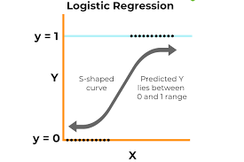
Logistic Regression Algorithm
What is Logistic Regression:
  It is a supervised classification algorithm used to predict whether an input belongs to class 0 or class 1 (Legitimate or Fraud).
  Works by calculating a weighted combination of input features and passing it through a sigmoid function to output probability between 0 and 1.
  If Probability > Threshold (0.5), the model predicts Fraud = 1, Otherwise Legit = 0

Slide 19
How Logistic Regression Works
Takes input features – Transaction amount, account balance, transaction type, etc.)
Compute Linear Equation:
  Z = w1x1 + w2x2 + … + b
Apply the sigmoid function:
  σ(z)=1 / (1+e^-z)​
Outputs a probability of fraud
Compares probability to threshold set to 0.5 → outputs class (0 or 1)

Slide 20
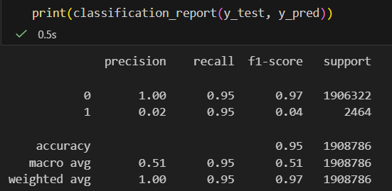
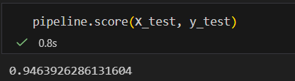
Model Performance:
Low Precision = Lot of False Positives!

Slide 21
Logistic Regression: What went Wrong
The data was Highly Imbalanced:
  Less than 1% of the entire data was fraud.
Logistic Regression is too simple:
  It assumes linear separation, but fraud patterns are non-linear and complex.
  Fails to capture interactions between features like:
    sudden balance drops
    chain of transfers
    unusual patterns in destination accounts
    aggregated behavior
Poor Precision on Fraud:
  The model marks majority of the transactions as fraud even though only 1% of the entries are actually fraud, making it unreliable.
  In fraud detection, precision and recall is far more important than accuracy.

Slide 22
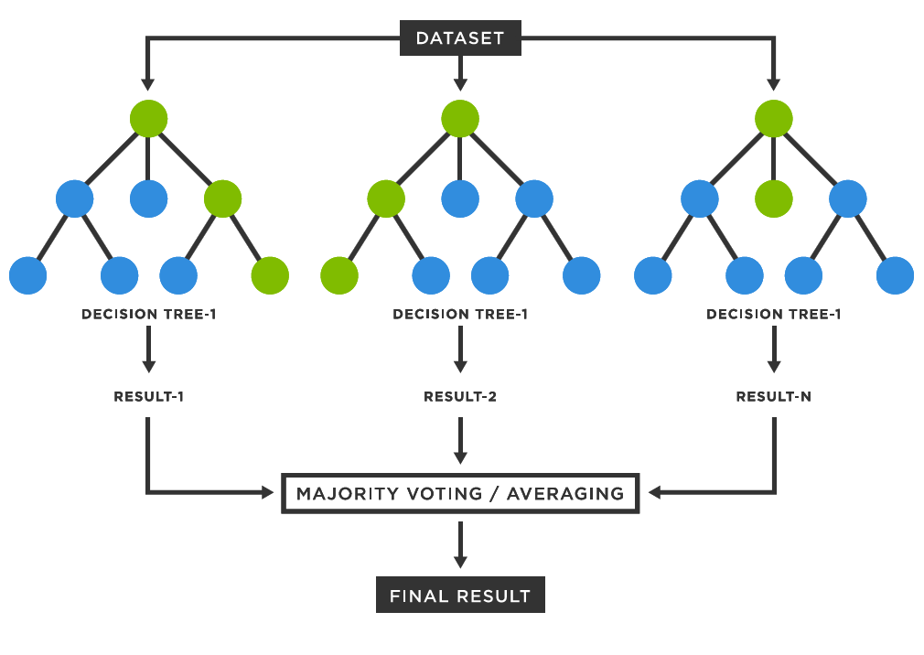
Random Forest Algorithm
(Final Choice for Model)
What is Random Forest
  A supervised machine learning algorithm that builds many decision trees and combines their outputs.
  Each tree “votes,” and the final prediction is decided by majority vote.
  Works extremely well for complex, non-linear patterns — which is perfect for fraud detection.

Slide 23
How Random Forest Works
Creates many decision trees using different random subsets of:
  the data (bootstrapping)
  the features (random feature selection)
Each tree learns a slightly different pattern.
During prediction:
  Each tree gives a classification (fraud/not fraud)
  Random Forest takes the majority vote

Slide 24
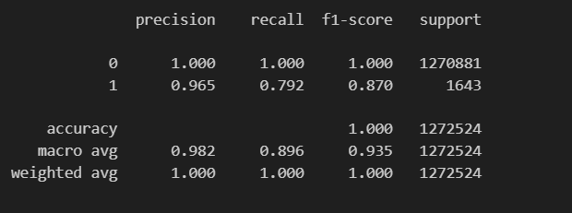
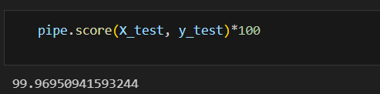
Model Performance

Slide 25
Why Random Forest is a better Choice?
Handles Non-Linear Patterns
  Fraud patterns aren’t linear — Random Forest captures complex relationships between features.
Works Better With Categorical / Noisy Data
Tree-based models naturally split on categories (like transaction type).
More Robust to Data Imbalance
  It doesn't default to predicting only the majority class.
Reduces Overfitting
  Each tree is slightly different; combined, they generalize better than a single model.
Feature Importance
  Shows which features matter most:
    transaction amount
    origin balance differences
    destination balance changes
    transaction type
    (Helps interpret Fraud behavior)

Slide 26
Improvements to the Model and Future Work
Recall for Fraud is 0.792, which is pretty good
To improve performance, we made the model more sensitive to frauds by bringing down the threshold from 0.5 to 0.1. This means that the model won’t take any risk of passing a fraud transaction as legitimate and flag any transaction that has a confidence of more than 10% for being fraud.
For future, we want to try to bring the recall to 0.90 in order to further enhance the performance of the model and eliminate any remaining false negatives.
Hyperparameter Tuning:
  For a better recall, we can try using more and deeper trees.
  This may help catch larger percentage of actual frauds.

Slide 27
Chatbot Integration
Used Open AI API to integrate the chatbot into the model.
Takes the following input:
  Transaction Type
  Old Victim Account Balance
  New Victim Account Balance
  Old Account Balance of Attacker
  New Account Balance of Attacker
  Prediction from the model
  The bot uses this information to create a reasonable justification for the model’s prediction and summarizes it to the user in simple natural language. This way, our fraud detection system reduces human fatigue as the human analyzer is already presented an easy-to-understand summary of the nature of a particular transaction.

Slide 28
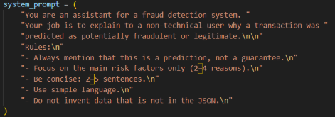
Prompt Used for AI Explanation Bot
The image here shows the prompt we gave to the OpenAI API in order to generate an easy to understand explanation for a flagged transaction. The chatbot is instructed to use the input data to generate brief explanation of 2-5 sentences. We also instructed it to not invent data as OpenAI LLMs tend to do that sometimes.

Slide 29
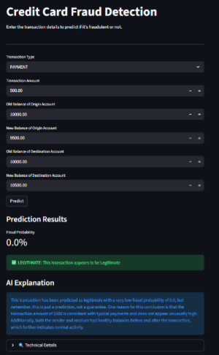
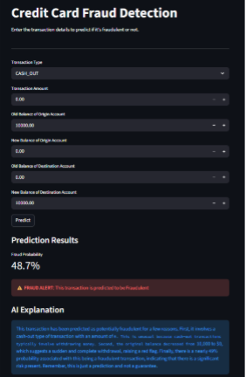
Current working model
Legitimate Transaction
Fraud Transaction

Slide 30
Conclusion
Fraud Detection has transformed drastically along with the growth of AI and Machine Learning Technologies.
Modern Fraud Detectors can use ML algorithms to detect common fraud patterns given a set of existing data.
Given the drastic imbalance between fraud and non-fraud in the dataset, with fraud being less than 1%, using logistic regression can give inaccurate results.
Random Forest Algorithm handles this problem better but still need to improve recall to be at least 90%.
Adding a chatbot reduces human fatigue and saves time in analyzing reason for a flagged fraud transaction.

Slide 31
Thank You!

Slide 32
References
[1]Data Science with Onur, “Fraud Detection Using Machine Learning – Full Python Data Science Project (94% Accuracy),” YouTube, Apr. 21, 2025. https://www.youtube.com/watch?v=4Od5_z28iIE (accessed Nov. 16, 2025).
[2]GeeksforGeeks, “Random Forest Algorithm in Machine Learning,” GeeksforGeeks, Feb. 22, 2024. https://www.geeksforgeeks.org/machine-learning/random-forest-algorithm-in-machine-learning/
[3]Sruthi, “Random Forest | Introduction to Random Forest Algorithm,” Analytics Vidhya, Jun. 17, 2021. https://www.analyticsvidhya.com/blog/2021/06/understanding-random-forest/

